Slide 1
NLP

Slide 2
Text Similarity
Wordnet

Slide 3
Wordnet
Wordnet is a project run by George Miller (1920-2012) and Christiane Fellbaum at Princeton University.
It includes a database of words (mainly nouns and verbs but also adjectives and adverbs) and semantic relations between them.
The main relation is hypernymy, so the overall structure of the database is more tree-like (see next slide).
References:
George A. Miller (1995). WordNet: A Lexical Database for English. Communications of the ACM Vol. 38, No. 11: 39-41.
Christiane Fellbaum (1998, ed.) WordNet: An Electronic Lexical Database. Cambridge, MA: MIT Press.

Slide 4
Tree-like structure of Wordnet
ungulate
even-toed ungulate
odd-toed ungulate
ruminant
equine
okapi
deer
giraffe
mule
horse
zebra
elk
wapiti
caribou
pony

Slide 5
Wordnet Example (1/6)
The noun bar has 11 senses
1. barroom, bar, saloon, ginmill, taproom -- (a room where alcoholic drinks are served over a counter)
2. bar -- (a counter where you can purchase food or drink)
3. bar -- (a rigid piece of metal)
4. measure, bar -- (notation for a repeating pattern of musical beats; written followed by a vertical bar)
5. bar -- (usually metal placed in windows to prevent escape)
6. prevention, bar -- (the act of preventing)
7. bar -- (a unit of pressure equal to a million dynes per square centimeter)
8. bar -- (a submerged (or partly submerged) ridge in a river or along a shore)
9. legal profession, bar, legal community -- (the body of individuals qualified to practice law)
10. cake, bar -- (a block of soap or wax)
11. bar -- ((law) a railing that encloses the part of the courtroom where the the judges and lawyers sit and the case is tried)
The verb bar has 4 senses
1. bar, debar, exclude -- (prevent from entering; keep out; "He was barred from membership in the club")
2. barricade, block, blockade, block off, block up, bar -- (render unsuitable for passage; "block the way"; "barricade the streets")
3. banish, relegate, bar -- (expel, as if by official decree; "he was banished from his own country")
4. bar -- (secure with, or as if with, bars; "He barred the door")

Slide 6
Wordnet Example (2/6)
Sense 1
barroom, bar, saloon, ginmill, taproom
=> room
=> area
=> structure, construction
=> artifact, artefact
=> object, physical object
=> entity, something
Sense 2
bar
=> counter
=> table
=> furniture, piece of furniture, article of furniture
=> furnishings
=> instrumentality, instrumentation
=> artifact, artefact
=> object, physical object
=> entity, something

Slide 7
Wordnet Example (3/6)
Sense 3
bar
=> implement
=> instrumentality, instrumentation
=> artifact, artefact
=> object, physical object
=> entity, something
Sense 4
measure, bar
=> musical notation
=> notation, notational system
=> writing, symbolic representation
=> written communication, written language
=> communication
=> social relation
=> relation
=> abstraction

Slide 8
Wordnet Example (4/6)
Sense 5
bar
=> obstruction, impediment, impedimenta
=> structure, construction
=> artifact, artefact
=> object, physical object
=> entity, something
Sense 6
prevention, bar
=> hindrance, interference, interfering
=> act, human action, human activity
Sense 7
bar
=> pressure unit
=> unit of measurement, unit
=> definite quantity
=> measure, quantity, amount, quantum
=> abstraction

Slide 9
Wordnet Example (5/6)
Sense 8
bar
=> ridge
=> natural elevation, elevation
=> geological formation, geology, formation
=> natural object
=> object, physical object
=> entity, something
=> barrier
=> mechanism
=> natural object
=> object, physical object
=> entity, something

Slide 10
Wordnet Example (6/6)
Sense 9
legal profession, bar, legal community
=> profession, community
=> occupation, vocation, occupational group
=> body
=> gathering, assemblage
=> social group
=> group, grouping
Sense 10
cake, bar
=> block
=> artifact, artefact
=> object, physical object
=> entity, something

Slide 11
Familiarity and Polysemy
board used as a noun is familiar (polysemy count = 9)
bird used as a noun is common (polysemy count = 5)
cat used as a noun is common (polysemy count = 7)
house used as a noun is familiar (polysemy count = 11)
information used as a noun is common (polysemy count = 5)
retrieval used as a noun is uncommon (polysemy count = 3)
serendipity used as a noun is very rare (polysemy count = 1)

Slide 12
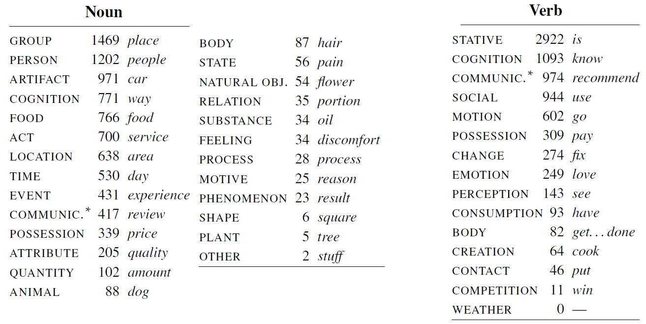
Top-Level Categories
[Example from J&M, based on Schneider and Smith 2013]

Slide 13
Text Similarity
Other Lexical Networks

Slide 14
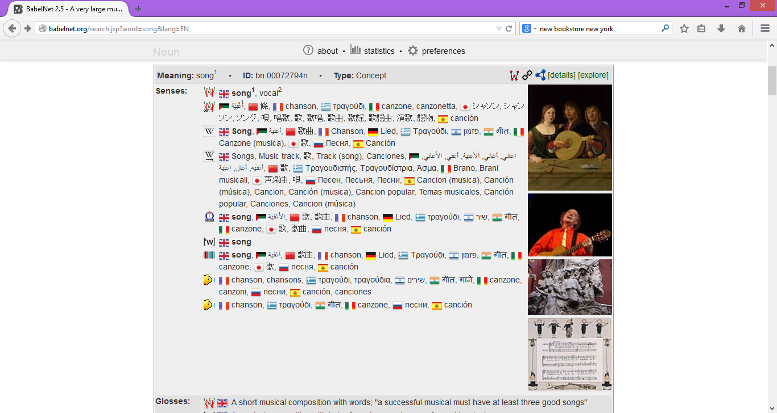
BabelNet Example

Slide 15
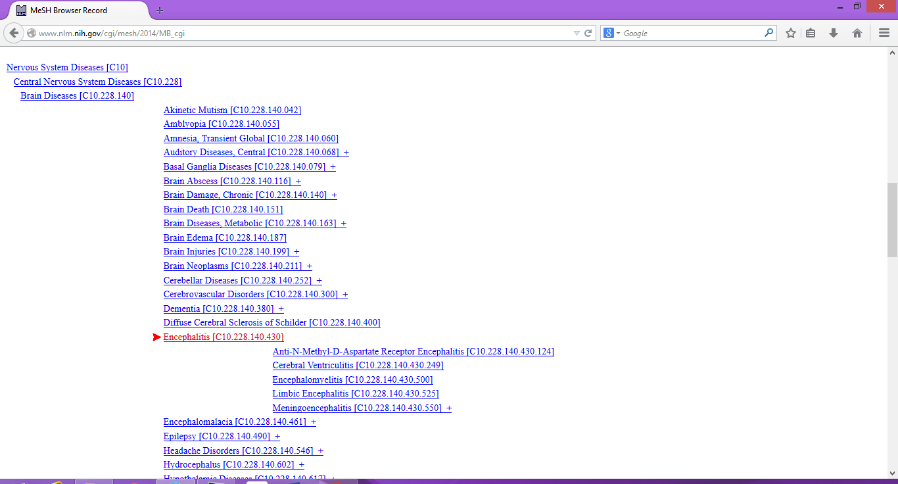
MeSH
Medical Subject Headings
http://www.nlm.nih.gov/mesh/MBrowser.html

Slide 16
External Links
EuroWordNet
http://www.illc.uva.nl/EuroWordNet/
Open Thesaurus
http://www.openthesaurus.de/
Freebase
http://www.freebase.com
DBPedia
http://www.dbpedia.org
BabelNet
http://babelnet.org
Various thesauri
https://sites.google.com/site/openrogets/

Slide 17
NLP

